Slide 1
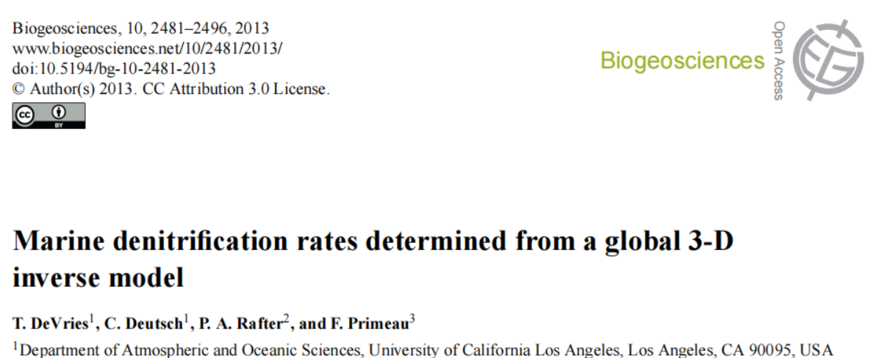

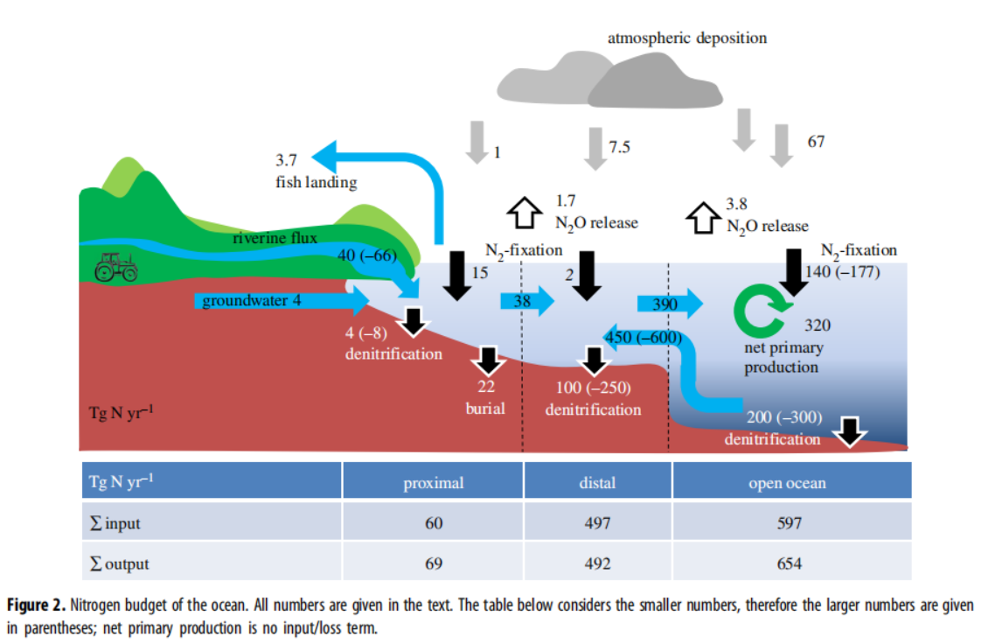
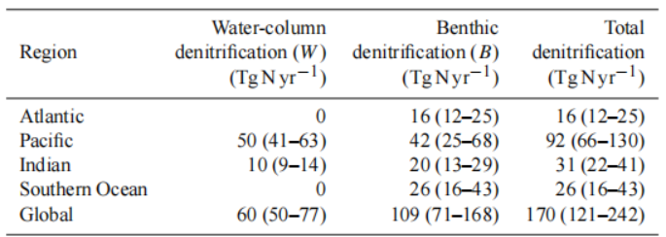

NH4_Nfix_P =15 Tg N/yr / 14= 1.07e12 mol N/yr
NH4_Nfix_D =2 Tg N/yr / 14= 0.14e12 mol N/yr
NH4_Nfix_S = 140 Tg N/yr / 14 = 10e12 mol N/yr
NO3_denit_P = 4 Tg N/yr / 14= 0.29e12 mol N/yr
NO3_denit_D = 100 Tg N/yr / 14= 7.2e12 mol N/yr
NO3_denit_S = 60 Tg N/yr / 14= 4.28e12 mol N/yr
NO3_denit_DP = 110 Tg N/yr / 14= 7.85e12 mol N/yr
In COPSE model

Slide 2
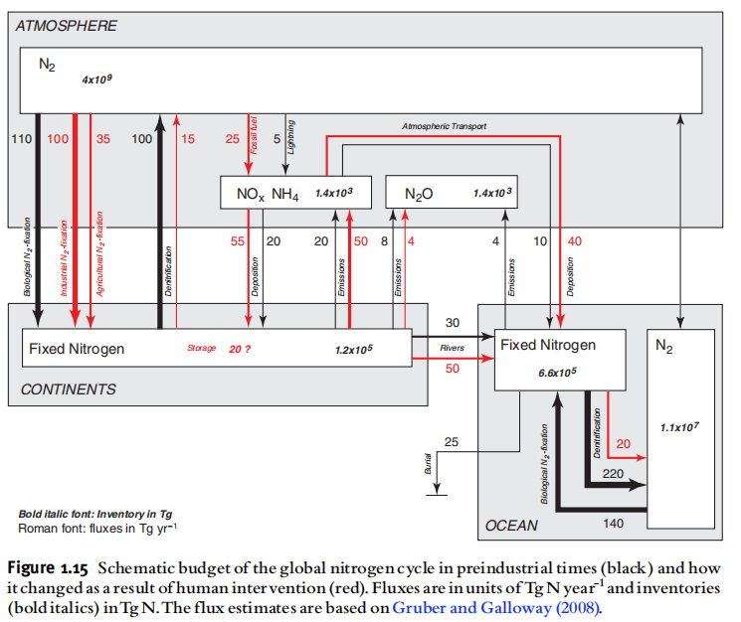
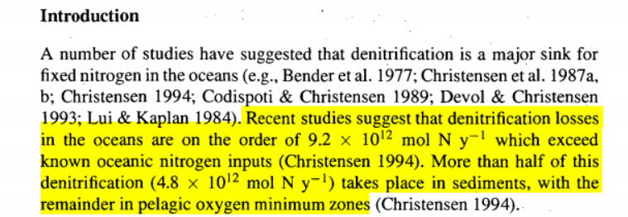
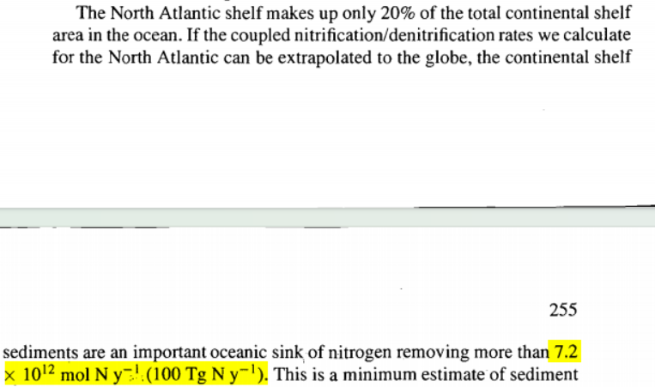
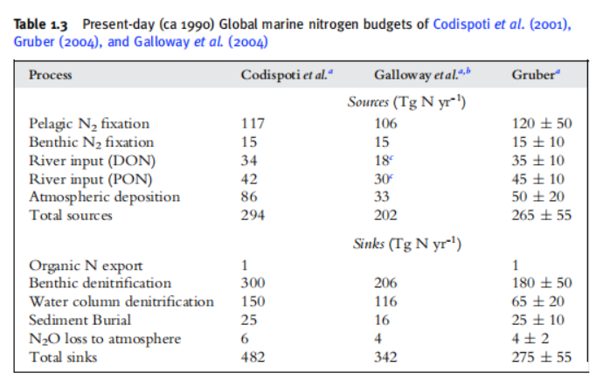
Consistent with surface and deep ocean zone above
Total continental shelf, Consistent with Distal zone above

Slide 3
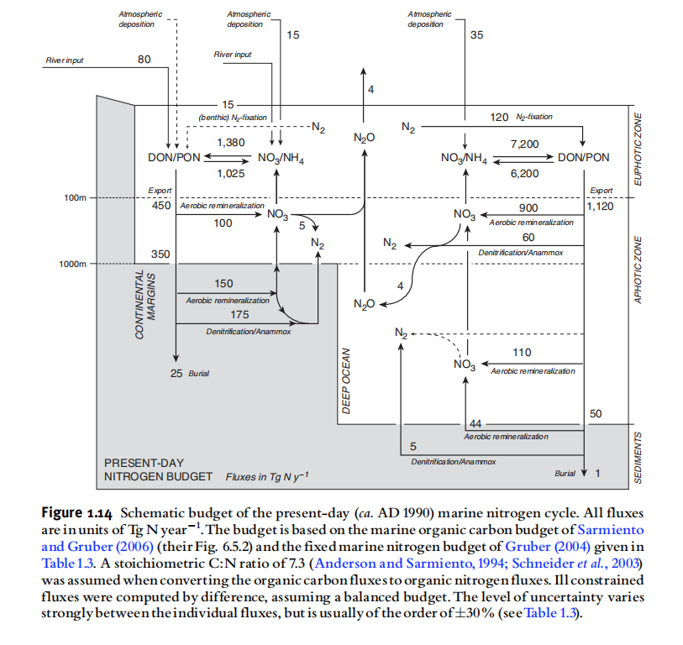
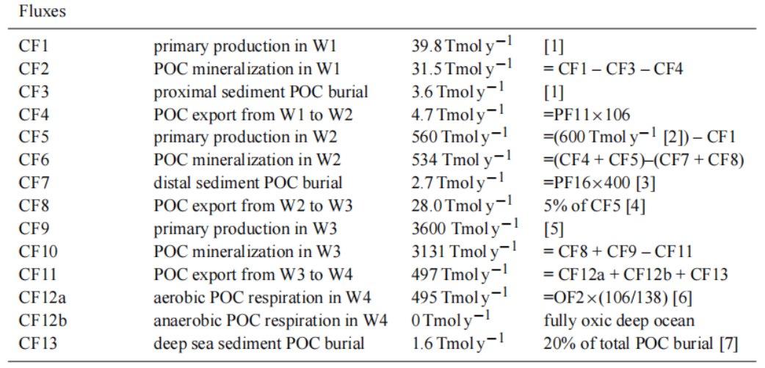
Consistent with data above
We known.....
PP_P_0_C = 3.975e13 mol y⁻¹
PP_D_0 _C = 5.6e14 mol y⁻¹
PP_S_0 _C = 3.8688e15 mol y⁻¹
Then.....
PP_P_0_N = 3.975e13/6.6*14= 84.3 Tg N y⁻¹
PP_D_0 _N = 5.6e14/6.6*14= 1178.9 Tg N y⁻¹
PP_S_0 _N = 3.8688e15/6.6*14=8206.5 Tg N y⁻¹
This is similar to the figure
Therefore, the quantity of N can be directly deduced from the known primary production C and remineralization C？

Slide 4
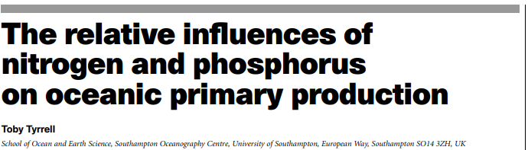
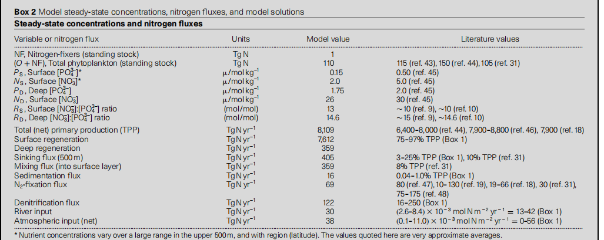

Slide 5
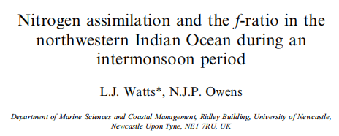
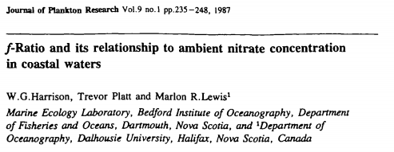
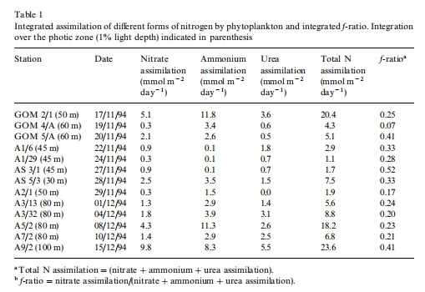
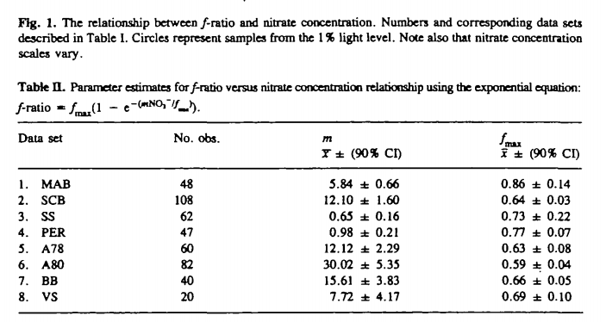
We known....NH4_PP + NO3_PP = N_PP
Then we found.....F-ratio=nitrate uptake / (nitrate+ammonium+other N) uptake
F-ratio≈0.7
≈2.43
≈4.07
F-ratio=0.37

Slide 6
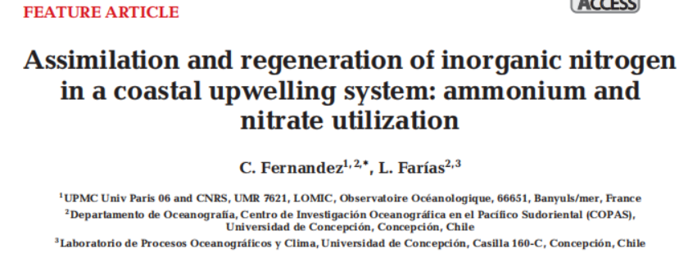
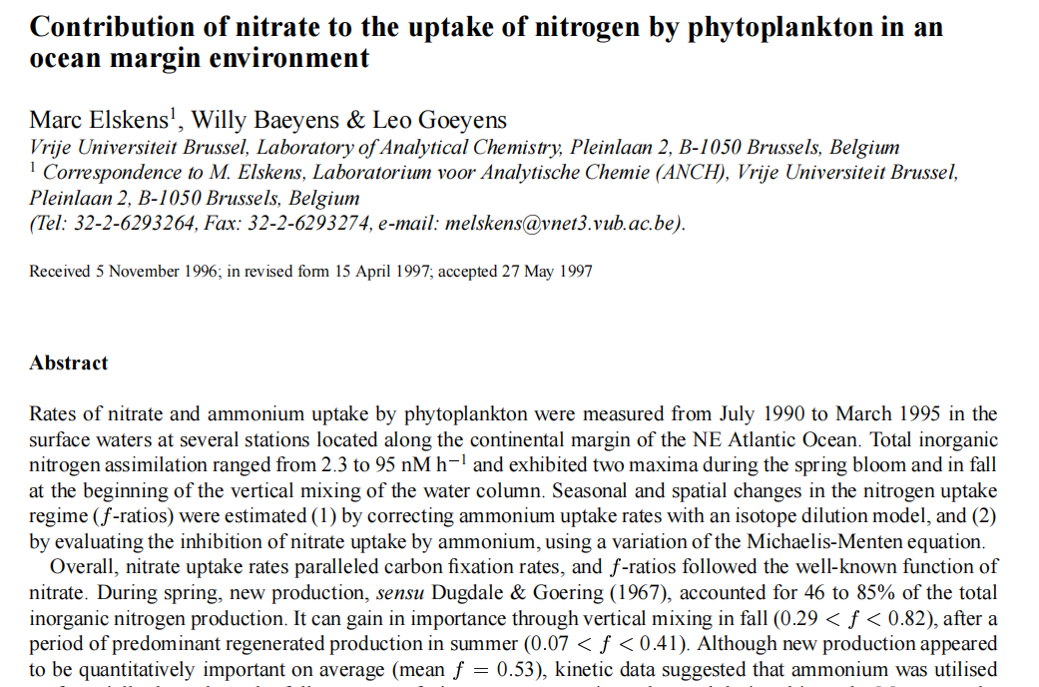
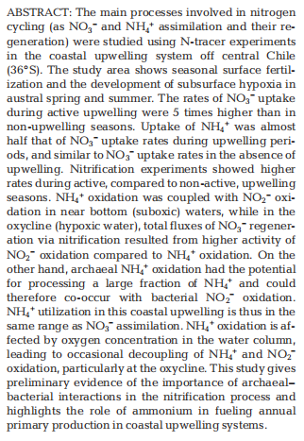

Slide 7
